Slide 1




Difficult to diagnose fungal infections: Non-fungaemic candidiasis
Cornelius J. Clancy, M.D.
Director, Mycology Research Unit Chief, Infectious Diseases
and XDR Pathogen Laboratory VA Pittsburgh Healthcare System
University of Pittsburgh
8th Trends in Medical Mycology
Belgrade, Serbia
7 October 2017

Slide 2
Disclosures and conflicts of interest
Site PI, T2 Biosystems clinical trials
DIRECT2, DIRECT1
Laboratory funding from NIH and VA grants
UPMC funds the XDR Pathogen Lab
Pfizer, MSD, Astellas, Cidara, CSL-Behring support for investigator-initiated research projects
MSD, Astellas, Cidara, Scynexis, Medicines Company, Sinoygi advisory boards
No financial holdings

Slide 3



Slide 4
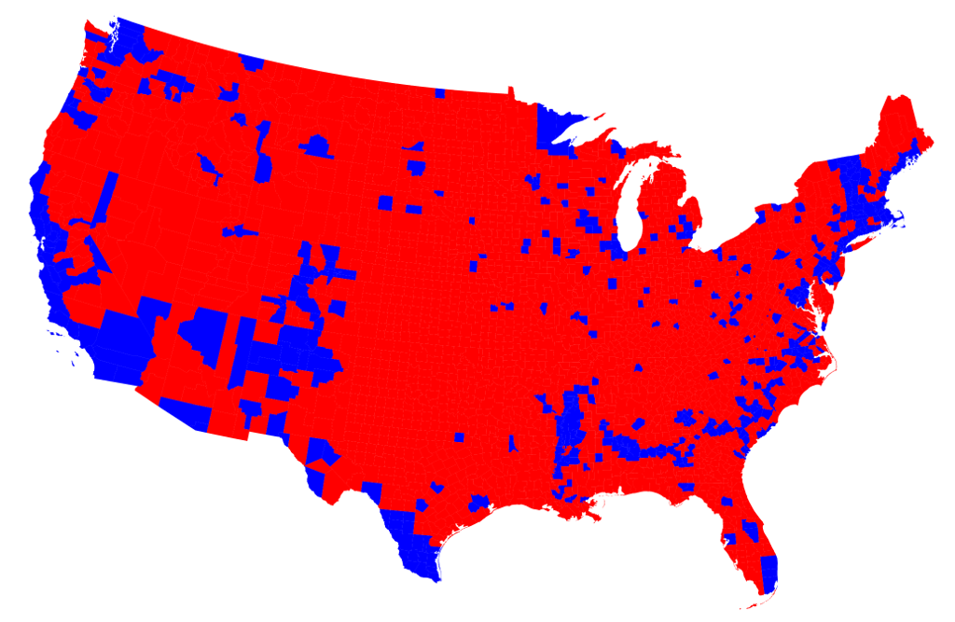
Pittsburgh

Slide 5
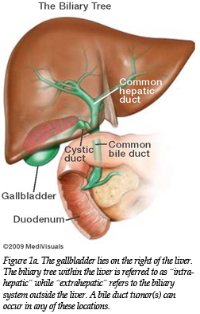
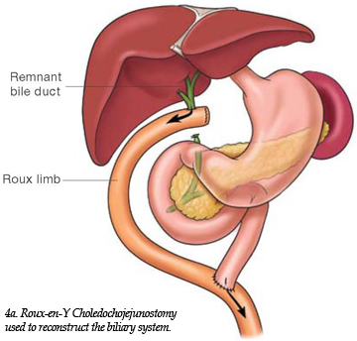
Let’s start with a case
A 64 year-old man underwent right extended hepatectomy with Roux-en-Y biliary reconstruction and cholodochojejunostomy for a non-malignant hepatic mass

Slide 6
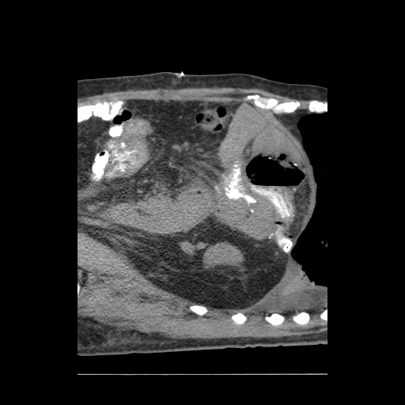
Let’s start with a case
Encephalopathy, acute kidney injury, leukocytosis
Vancomycin and pipercillin-tazobactam
Two weeks post-operatively, he developed fevers and worsening leukocytosis

Slide 7
Let’s start with a case
Encephalopathy, acute kidney injury, leukocytosis
Vancomycin and pipercillin-tazobactam
Two weeks post-operatively, he developed fevers and worsening leukocytosis
Abscess culture: (+) E. coli, vancomycin resistant Enterococcus (VRE)
Blood culture: (+) E. coli
Surgical drainage
Linezolid and pipercillin-tazobactam

Slide 8
Our case
Blood and surgical drainage cultures negative for Candida spp.
ID consult
Would you initiate antifungal therapy?
T2Candida + for C. glabrata/C. krusei
What is the likelihood of IC?

Slide 9
Our case
Blood and surgical drainage cultures negative for Candida spp.
ID consult
Would you initiate antifungal therapy?
T2Candida + for C. glabrata/C. krusei
What is the likelihood of IC?

Slide 10
Outline
Case presentation
Spectrum of invasive candidiasis
Diagnostic tests for invasive candidiasis
Culture
Non-culture diagnostics
T2Candida
How to use non-culture tests
Case resolution
Conclusions

Slide 11
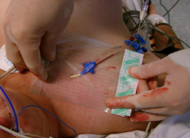
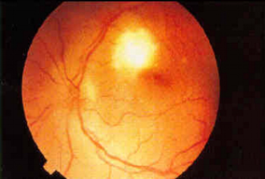
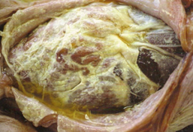
Cumulative Experience and Key Findings
Spectrum of invasive candidiasis
1. Candidemia
3. DSC without candidemia
2. Candidemia with DSC
Clancy and Nguyen
Clin Infect Dis 2013
~ 1/3 of patients in each group Leroy 2009

Slide 12
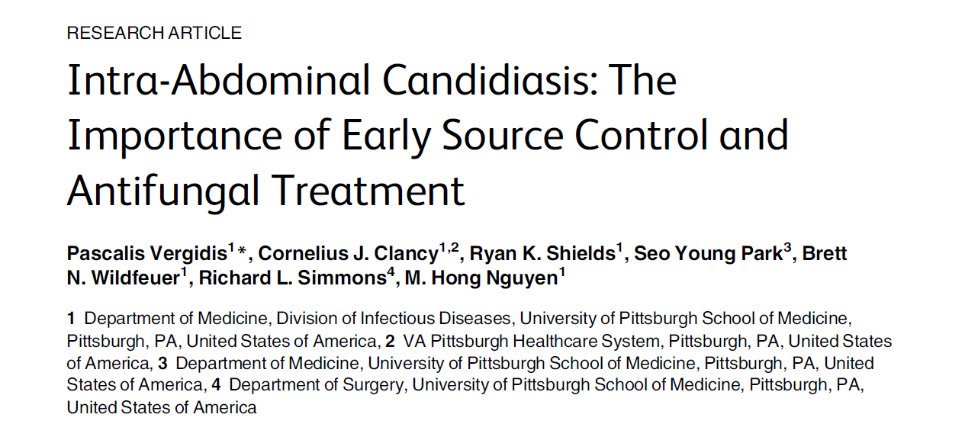

Slide 13
Cumulative Experience and Key Findings
How do blood cultures perform?
1. Candidemia
3. DSC without candidemia
Almost all
<20%
2. Candidemia with DSC
~40%
Blood culture sensitivity for IC is ~50%
“The Missing 50%” Clancy and Nguyen, Clin Infect Dis 2013

Slide 14
Cumulative Experience and Key Findings
How do blood cultures perform?
~30%
1. Candidemia
3. DSC without candidemia
Almost all
<20%
2. Candidemia with DSC
~40%
Blood culture sensitivity for IC is ~50%
“The Missing 50%” Clancy and Nguyen, Clin Infect Dis 2013

Slide 15
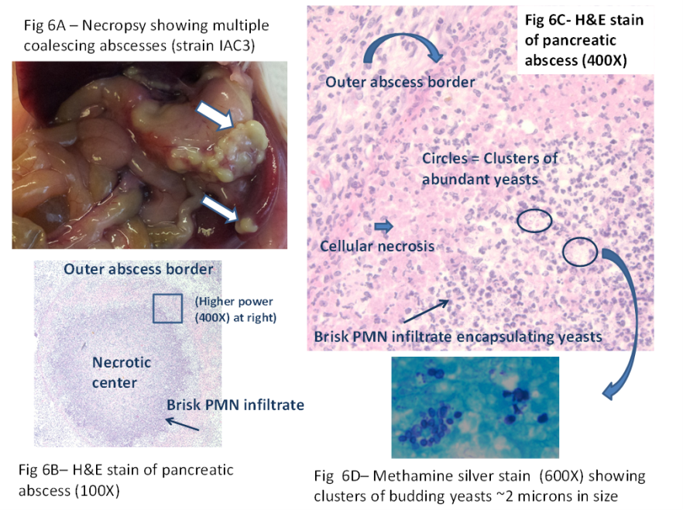
How about cultures of other sterile sites?
Biopsy culture sensitivity: 42% Thaler Annals Int Med 1988
Invasive procedures are often contra-indicated or delayed
Cheng JID 2013
Cheng Infect Immun 2014

Slide 16
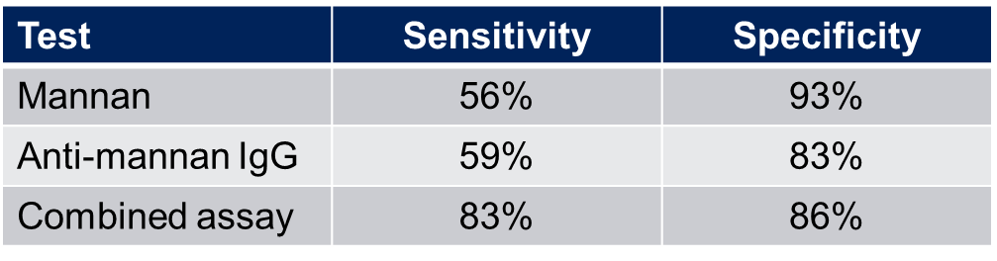
Non-culture diagnostics
C. albicans germ tube antibody (CATGA)
Preliminary sensitivity/specificity: 84%/95% Moragues Enferm Infecc Microbiol Clin 2004
Most recent study of candidemia: 76%-86%/76%-80% Parra Sanchez Mycopathologica 2017
Mannan-Antimannan
Meta-analysis of 14 studies Mikulska 2010
Best performance for C. albicans, C. glabrata, C. tropicalis

Slide 17
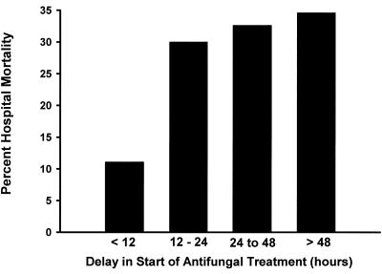
asβ-1,3-D-glucan
Sensitivity across studies: 57%-97%
Specificity across studies: 56%-93%
Meta-analyses: ~ 80%/80% Karageorgopoulos 2011; Onishi 2012; He 2014
True positives are not specific for Candida
Major limitation is false positives
797 serum samples from 73 lung transplant recipients Alexander 2010
Per patient/Per sample performance
Sensitivity 64%/71%
Specificity 9%/59%
PPV 14%/9%
NPV 50%/97%

Slide 18
asβ-1,3-D-glucan
Sensitivity across studies: 57%-97%
Specificity across studies: 56%-93%
Meta-analyses: ~ 80%/80% Karageorgopoulos 2011; Onishi 2012; He 2014
True positives are not specific for Candida
Major limitation is false positives
797 serum samples from 73 lung transplant recipients Alexander 2010
Per patient/Per sample performance
Sensitivity 64%/71%
Specificity 9%/59%
PPV 14%/9%
NPV 50%/97%

Slide 19
Candida PCR or outcomes
Numerous publications totaling >5000 patients (blood fractions testing)
Lack of standardization, clinical validation, demonstrated clinical benefits and multi-center studies
Nucleic acid detection platform, blood fraction, extraction methods, targets, post-PCR analysis
Highly heterogenous study designs, case definitions, types of disease, controls, inclusion of colonization, timing of samples

Slide 20

PCR clinical studies or outcomes
Meta-analysis Avni 2011
Suspected IC
Pooled sensitivity/specificity: 95%/92%
Probable IC
Sensitivity 85% vs 38% for blood culture

Slide 21
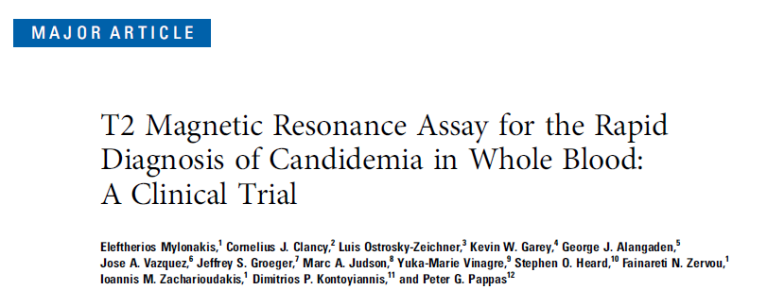
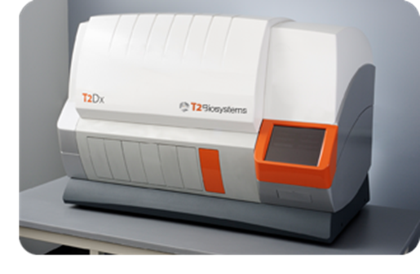
associated with poor outcomes
T2Candida
DIRECT1 Trial
Whole blood assay in self-contained system
Big 5 Candida species
Ca/Ct, Cg/Ck, Cp
FDA cleared for diagnosing candidemia Mylonakis Clin Infect Dis 2015
1500 patients in whom blood cultures were collected
250 spiked blood samples
Sensitivity/Specificity: 91%/98%
Limited data on clinical samples from patients with candidemia

Slide 22
associated with poor outcomes
T2Candida
DIRECT1 Trial
Whole blood assay in self-contained system
Big 5 Candida species
Ca/Ct, Cg/Ck, Cp
FDA cleared for diagnosing candidemia Mylonakis Clin Infect Dis 2015
1500 patients in whom blood cultures were collected
250 spiked blood samples
Sensitivity/Specificity: 91%/98%
Limited data on clinical samples from patients with candidemia

Slide 23
DIRECT2 Study Summary
DIRECT2 Trial
Objective
Determine the clinical sensitivity of T2Candida among patients with active candidemia
Determine the performance of T2Candida with recent positive blood cultures
14 centers in U.S.
N=152 proven candidemic patients due to Big 5 species
Identified by positive diagnostic blood culture (dBC)
Follow-up samples collected concurrently for T2Candida/companion blood culture (cBC)

Slide 24
DIRECT2 Study Summary
DIRECT2 Trial
T2Candida clinical sensitivity: 89%
cBC+
n=36
T2+, n=32
(89%)
T2-, n=4
(11%)
T2+/cBC-, n=37

Slide 25
How about non-fungaemic invasive candidiasis?
CID 2012; 54:1240
Assay | IC (n=55)
PCR Sensitivity Specificity | 80% (44/55) 70% (51/73)
BDG (>80 pmol/mL) Sensitivity Specificity | 56% (31/55) 73% (53/73)
p values PCR vs. BDG | 0.03

Slide 26
How about non-fungaemic invasive candidiasis?
CID 2012; 54:1240
Assay | IC (n=55) | DSC (n=38) | IAC (n=34)
PCR Sensitivity Specificity | 80% (44/55) 70% (51/73) | 89% (34/38) | 88% (30/34)
BDG (>80 pmol/mL) Sensitivity Specificity | 56% (31/55) 73% (53/73) | 53% (20/38) | 56% (19/34)
p values PCR vs. BDG | 0.03 | 0.004 | 0.0015

Slide 27
How about non-fungaemic invasive candidiasis?
CID 2012; 54:1240
Assay | IC (n=55) | DSC (n=38) | IAC (n=34)
PCR Sensitivity Specificity | 80% (44/55) 70% (51/73) | 89% (34/38) | 88% (30/34)
BDG (>80 pmol/mL) Sensitivity Specificity | 56% (31/55) 73% (53/73) | 53% (20/38) | 56% (19/34)
p values PCR vs. BDG | 0.03 | 0.004 | 0.0015
Blood culture
17%

Slide 28
How about non-fungaemic invasive candidiasis?
Prospective, multi-center Swiss study of BDG in diagnosing IAC among surgical ICU patients Tissot 2013
BDG sensitivity/specificity (consecutive +): 65%/78%
Blood culture sensitivity: 7% (2/29)

Slide 29
How about non-fungaemic invasive candidiasis?
Prospective, multi-center Swiss study of BDG in diagnosing IAC among surgical ICU patients Tissot 2013
BDG sensitivity/specificity (consecutive +): 65%/78%
Blood culture sensitivity: 7% (2/29)
Knitsch, INTENSE, Clin Infect Dis 2015
BDG OR: 3.7
Nguyen 56%/73%
Nguyen 17%

Slide 30
How about non-fungaemic invasive candidiasis?
63 ICU patients with suspected invasive candidiasis
27 patients confirmed
40 healthy controls
Sensitivity/specificity for deep seated candidiasis
BDG: 64%/83%
CAGTA: 73%/54% Multiplex quantitative real-time PCR (MRT-PCR): 91%/97%

Slide 31
How about non-fungaemic invasive candidiasis?
63 ICU patients with suspected invasive candidiasis
27 patients confirmed
40 healthy controls
Sensitivity/specificity for deep seated candidiasis
BDG: 64%/83%
CAGTA: 73%/54% 61%-67%/76%-80% Parra Sanchez 2017
Multiplex quantitative real-time PCR (MRT-PCR): 91%/97%

Slide 32
How about non-fungaemic invasive candidiasis?
63 ICU patients with suspected invasive candidiasis
27 patients confirmed
40 healthy controls
Sensitivity/specificity for deep seated candidiasis
BDG: 64%/83%
CAGTA: 73%/54% 61%-67%/76%-80% Parra Sanchez 2017
Multiplex quantitative real-time PCR (MRT-PCR): 91%/97%
PCR superior!

Slide 33
How about non-fungaemic invasive candidiasis?
233 non-neutropenic ICU patients with severe abdominal conditions
31 developed culture-proven invasive candidiasis
Sensitivity/Specificity
BDG (2 consecutive positive): 77%/57%
CAGTA (2 consecutive positive): 53%/64%
MRT-PCR: 84%/33%

Slide 34
How about non-fungaemic invasive candidiasis?
233 non-neutropenic ICU patients with severe abdominal conditions
31 developed culture-proven invasive candidiasis
Sensitivity/Specificity
BDG (2 consecutive positive): 77%/57%
CAGTA (2 consecutive positive): 53%/64%
MRT-PCR: 84%/33%

Slide 35
How about non-fungaemic invasive candidiasis?
Test | Sensitivity | Specificity | Study
BDG | 60% | 73% | Nguyen
 | 65% | 78% | Tissot
 | 64% | 83% | Fortun
 | 77% | 57% | Leon

Slide 36
How about non-fungaemic invasive candidiasis?
Test | Sensitivity | Specificity | Study
BDG | 60% | 73% | Nguyen
 | 65% | 78% | Tissot
 | 64% | 83% | Fortun
 | 77% | 57% | Leon
CAGTA | 73% | 54% | Fortun
 | 65% | 80% | Parra Sanchez
 | 53% | 64% | Leon

Slide 37
How about non-fungaemic invasive candidiasis?
Test | Sensitivity | Specificity | Study
BDG | 60% | 73% | Nguyen
 | 65% | 78% | Tissot
 | 64% | 83% | Fortun
 | 77% | 57% | Leon
CAGTA | 73% | 54% | Fortun
 | 65% | 80% | Parra Sanchez
 | 53% | 64% | Leon
Mannan/ Antimannan | Generally slightly inferior to BDG, CAGTA

Slide 38
How about non-fungaemic invasive candidiasis?
Test | Sensitivity | Specificity | Study
BDG | 60% | 73% | Nguyen
 | 65% | 78% | Tissot
 | 64% | 83% | Fortun
 | 77% | 57% | Leon
CAGTA | 73% | 54% | Fortun
 | 65% | 80% | Parra Sanchez
 | 53% | 64% | Leon
Mannan/ Antimannan | Generally slightly inferior to BDG, CAGTA
PCR | 91% | 97% | Fortun
 | 80% | 70% | Nguyen
 | 84% | 33% | Leon
T2Candida | No data

Slide 39
Outline
Case presentation
Spectrum of invasive candidiasis
Diagnostic tests for invasive candidiasis
Culture
Non-culture diagnostics
T2Candida
How to use non-culture tests
Case resolution
Conclusions
Bayesian framework
PPV/NPV

Slide 40
Outline
Case presentation
Spectrum of invasive candidiasis
Diagnostic tests for invasive candidiasis
Culture
Non-culture diagnostics
T2Candida
How to use non-culture tests
Case resolution
Conclusions
PPV/NPV
Bayesian framework

Slide 41
Most common type of IC | Pre-test likelihood of IC* | Corresponding patient populations | Leon Sens 80%/Spec 33% |  | Pittsburgh Sens 80%/Spec 70% |  | Fortun Sens 90%/Spec 98%
 |  |  | PPV | NPV | PPV | NPV | PPV | NPV
Primary IAC†† (Group 3) | 3% | - Low-to-moderate risk liver transplant††† | 4% | 98% | 8% | 99% | 67% | 99.7%
 | 5% | - Low-to-moderate risk peritoneal dialysis with peritonitis | 6% | 97% | 12% | 99% | 83% | >99%
 | 10% | - Moderate-risk liver transplant - Post-colon perforation | 12% | 94% | 23% | 97% | 91% | 99%
 | 20% | -High-risk severe acute or necrotizing pancreatitis -Post-small bowel perforation | 23% | 87% | 40% | 93% | 94% | 98%
 | 30% | - High-risk liver transplant - High-risk GI surgery - Post-Biliary leak - Post-Gastric/Duodenal perforation | 34% | 79% | 53% | 89% | 97% | 96%

Slide 42
Most common type of IC | Pre-test likelihood of IC* | Corresponding patient populations | BDG Sens 60%/Spec 75% |  | Pittsburgh Sens 80%/Spec 70% |  | Fortun Sens 90%/Spec 98%
 |  |  | PPV | NPV | PPV | NPV | PPV | NPV
Primary IAC†† (Group 3) | 3% | - Low-to-moderate risk liver transplant††† | 7% | 98% | 8% | 99% | 67% | 99.7%
 | 5% | - Low-to-moderate risk peritoneal dialysis with peritonitis | 11% | 97% | 12% | 99% | 83% | >99%
 | 10% | - Moderate-risk liver transplant - Post-colon perforation | 21% | 94% | 23% | 97% | 91% | 99%
 | 20% | -High-risk severe acute or necrotizing pancreatitis -Post-small bowel perforation | 32% | 88% | 40% | 93% | 94% | 98%
 | 30% | - High-risk liver transplant - High-risk GI surgery - Post-Biliary leak - Post-Gastric/Duodenal perforation | 51% | 78% | 53% | 89% | 97% | 96%

Slide 43
Most common type of IC | Pre-test likelihood of IC* | Corresponding patient populations | BDG Sens 60%/Spec 75% |  | Pittsburgh Sens 80%/Spec 70% |  | Fortun Sens 90%/Spec 98%
 |  |  | PPV | NPV | PPV | NPV | PPV | NPV
Primary IAC†† (Group 3) | 3% | - Low-to-moderate risk liver transplant††† | 7% | 98% | 8% | 99% | 67% | 99.7%
 | 5% | - Low-to-moderate risk peritoneal dialysis with peritonitis | 11% | 97% | 12% | 99% | 83% | >99%
 | 10% | - Moderate-risk liver transplant - Post-colon perforation | 21% | 94% | 23% | 97% | 91% | 99%
 | 20% | -High-risk severe acute or necrotizing pancreatitis -Post-small bowel perforation | 32% | 88% | 40% | 93% | 94% | 98%
 | 30% | - High-risk liver transplant - High-risk GI surgery - Post-Biliary leak - Post-Gastric/Duodenal perforation | 51% | 78% | 53% | 89% | 97% | 96%

Slide 44
Most common type of IC | Pre-test likelihood of IC* | Corresponding patient populations | BDG Sens 60%/Spec 75% |  | Pittsburgh Sens 80%/Spec 70% |  | Fortun Sens 90%/Spec 98%
 |  |  | PPV | NPV | PPV | NPV | PPV | NPV
Primary IAC†† (Group 3) | 3% | - Low-to-moderate risk liver transplant††† | 7% | 98% | 8% | 99% | 67% | 99.7%
 | 5% | - Low-to-moderate risk peritoneal dialysis with peritonitis | 11% | 97% | 12% | 99% | 83% | >99%
 | 10% | - Moderate-risk liver transplant - Post-colon perforation | 21% | 94% | 23% | 97% | 91% | 99%
 | 20% | -High-risk severe acute or necrotizing pancreatitis -Post-small bowel perforation | 32% | 88% | 40% | 93% | 94% | 98%
 | 30% | - High-risk liver transplant - High-risk GI surgery - Post-Biliary leak - Post-Gastric/Duodenal perforation | 51% | 78% | 53% | 89% | 97% | 96%

Slide 45
Most common type of IC | Pre-test likelihood of IC* | Corresponding patient populations | Leon Sens 80%/Spec 33% |  | Pittsburgh Sens 80%/Spec 70% |  | Fortun Sens 90%/Spec 98%
 |  |  | PPV | NPV | PPV | NPV | PPV | NPV
Primary IAC†† (Group 3) | 3% | - Low-to-moderate risk liver transplant††† | 4% | 98% | 8% | 99% | 67% | 99.7%
 | 5% | - Low-to-moderate risk peritoneal dialysis with peritonitis | 6% | 97% | 12% | 99% | 83% | >99%
 | 10% | - Moderate-risk liver transplant - Post-colon perforation | 12% | 94% | 23% | 97% | 91% | 99%
 | 20% | -High-risk severe acute or necrotizing pancreatitis -Post-small bowel perforation | 23% | 87% | 40% | 93% | 94% | 98%
 | 30% | - High-risk liver transplant - High-risk GI surgery - Post-Biliary leak - Post-Gastric/Duodenal perforation | 34% | 79% | 53% | 89% | 97% | 96%

Slide 46
Most common type of IC | Pre-test likelihood of IC* | Corresponding patient populations | Leon Sens 80%/Spec 33% |  | Pittsburgh Sens 80%/Spec 70% |  | Fortun Sens 90%/Spec 98%
 |  |  | PPV | NPV | PPV | NPV | PPV | NPV
Primary IAC†† (Group 3) | 3% | - Low-to-moderate risk liver transplant††† | 4% | 98% | 8% | 99% | 67% | 99.7%
 | 5% | - Low-to-moderate risk peritoneal dialysis with peritonitis | 6% | 97% | 12% | 99% | 83% | >99%
 | 10% | - Moderate-risk liver transplant - Post-colon perforation | 12% | 94% | 23% | 97% | 91% | 99%
 | 20% | -High-risk severe acute or necrotizing pancreatitis -Post-small bowel perforation | 23% | 87% | 40% | 93% | 94% | 98%
 | 30% | - High-risk liver transplant - High-risk GI surgery - Post-Biliary leak - Post-Gastric/Duodenal perforation | 34% | 79% | 53% | 89% | 97% | 96%

Slide 47
Most common type of IC | Pre-test likelihood of IC* | Corresponding patient populations | Leon Sens 80%/Spec 33% |  | Pittsburgh Sens 80%/Spec 70% |  | Fortun Sens 90%/Spec 98%
 |  |  | PPV | NPV | PPV | NPV | PPV | NPV
Primary IAC†† (Group 3) | 3% | - Low-to-moderate risk liver transplant††† | 4% | 98% | 8% | 99% | 67% | 99.7%
 | 5% | - Low-to-moderate risk peritoneal dialysis with peritonitis | 6% | 97% | 12% | 99% | 83% | >99%
 | 10% | - Moderate-risk liver transplant - Post-colon perforation | 12% | 94% | 23% | 97% | 91% | 99%
 | 20% | -High-risk severe acute or necrotizing pancreatitis -Post-small bowel perforation | 23% | 87% | 40% | 93% | 94% | 98%
 | 30% | - High-risk liver transplant - High-risk GI surgery - Post-Biliary leak - Post-Gastric/Duodenal perforation | 34% | 79% | 53% | 89% | 97% | 96%

Slide 48
Most common type of IC | Pre-test likelihood of IC* | Corresponding patient populations | Leon Sens 80%/Spec 33% |  | Pittsburgh Sens 80%/Spec 70% |  | Fortun Sens 90%/Spec 98%
 |  |  | PPV | NPV | PPV | NPV | PPV | NPV
Primary IAC†† (Group 3) | 3% | - Low-to-moderate risk liver transplant††† | 4% | 98% | 8% | 99% | 67% | 99.7%
 | 5% | - Low-to-moderate risk peritoneal dialysis with peritonitis | 6% | 97% | 12% | 99% | 83% | >99%
 | 10% | - Moderate-risk liver transplant - Post-colon perforation | 12% | 94% | 23% | 97% | 91% | 99%
 | 20% | -High-risk severe acute or necrotizing pancreatitis -Post-small bowel perforation | 23% | 87% | 40% | 93% | 94% | 98%
 | 30% | - High-risk liver transplant - High-risk GI surgery - Post-Biliary leak - Post-Gastric/Duodenal perforation | 34% | 79% | 53% | 89% | 97% | 96%

Slide 49
Most common type of IC | Pre-test likelihood of IC* | Corresponding patient populations | Leon Sens 80%/Spec 33% |  | Pittsburgh Sens 80%/Spec 70% |  | Fortun Sens 90%/Spec 98%
 |  |  | PPV | NPV | PPV | NPV | PPV | NPV
Primary IAC†† (Group 3) | 3% | - Low-to-moderate risk liver transplant††† | 4% | 98% | 8% | 99% | 67% | 99.7%
 | 5% | - Low-to-moderate risk peritoneal dialysis with peritonitis | 6% | 97% | 12% | 99% | 83% | >99%
 | 10% | - Moderate-risk liver transplant - Post-colon perforation | 12% | 94% | 23% | 97% | 91% | 99%
 | 20% | -High-risk severe acute or necrotizing pancreatitis -Post-small bowel perforation | 23% | 87% | 40% | 93% | 94% | 98%
 | 30% | - High-risk liver transplant - High-risk GI surgery - Post-Biliary leak - Post-Gastric/Duodenal perforation | 34% | 79% | 53% | 89% | 97% | 96%

Slide 50
Most common type of IC | Pre-test likelihood of IC* | Corresponding patient populations | Leon Sens 80%/Spec 33% |  | Pittsburgh Sens 80%/Spec 70% |  | Fortun Sens 90%/Spec 98%
 |  |  | PPV | NPV | PPV | NPV | PPV | NPV
Primary IAC†† (Group 3) | 3% | - Low-to-moderate risk liver transplant††† | 4% | 98% | 8% | 99% | 67% | 99.7%
 | 5% | - Low-to-moderate risk peritoneal dialysis with peritonitis | 6% | 97% | 12% | 99% | 83% | >99%
 | 10% | - Moderate-risk liver transplant - Post-colon perforation | 12% | 94% | 23% | 97% | 91% | 99%
 | 20% | -High-risk severe acute or necrotizing pancreatitis -Post-small bowel perforation | 23% | 87% | 40% | 93% | 94% | 98%
 | 30% | - High-risk liver transplant - High-risk GI surgery - Post-Biliary leak - Post-Gastric/Duodenal perforation | 34% | 79% | 53% | 89% | 97% | 96%

Slide 51
Most common type of IC | Pre-test likelihood of IC* | Corresponding patient populations | Leon Sens 80%/Spec 33% |  | Pittsburgh Sens 80%/Spec 70% |  | Fortun Sens 90%/Spec 98%
 |  |  | PPV | NPV | PPV | NPV | PPV | NPV
Primary IAC†† (Group 3) | 3% | - Low-to-moderate risk liver transplant††† | 4% | 98% | 8% | 99% | 67% | 99.7%
 | 5% | - Low-to-moderate risk peritoneal dialysis with peritonitis | 6% | 97% | 12% | 99% | 83% | >99%
 | 10% | - Moderate-risk liver transplant - Post-colon perforation | 12% | 94% | 23% | 97% | 91% | 99%
 | 20% | -High-risk severe acute or necrotizing pancreatitis -Post-small bowel perforation | 23% | 87% | 40% | 93% | 94% | 98%
 | 30% | - High-risk liver transplant - High-risk GI surgery - Post-Biliary leak - Post-Gastric/Duodenal perforation | 34% | 79% | 53% | 89% | 97% | 96%

Slide 52
Back to our case
E. coli, VRE abscess
E. coli bacteremia
Blood and surgical drainage cultures negative for Candida spp.
ID consult
Would you initiate antifungal therapy?
T2Candida + for C. glabrata/C. krusei
What is the likelihood of IC?

Slide 53
What is the likelihood the patient has intra-abdominal candidiasis?
Post-operative biliary leak at two weeks
~30%

Slide 54
What is the likelihood the patient has intra-abdominal candidiasis?
Post-operative biliary leak at two weeks
~30%
Intra-abdominal cx (-) for Candida
~15%

Slide 55
What is the likelihood the patient has intra-abdominal candidiasis?
Post-operative biliary leak at two weeks
~30%
Intra-abdominal cx (-) for Candida
~15%
Blood cx (-) for Candida
~12%

Slide 56
What is the likelihood the patient has intra-abdominal candidiasis?
Post-operative biliary leak at two weeks
~30%
Intra-abdominal cx (-) for Candida
~15%
Blood cx (-) for Candida
~12%
T2Candida works like Pittsburgh PCR
(+) T2Candida: ~25%
If T2Candida was (-): ~3%
~10% Knitsch, INTENSE
Clin Infect Dis 2015

Slide 57
What is the likelihood the patient has intra-abdominal candidiasis?
Post-operative biliary leak at two weeks
~30%
Intra-abdominal cx (-) for Candida
~15%
Blood cx (-) for Candida
~12%
T2Candida works like Pittsburgh PCR
(+) T2Candida: ~25%
If T2Candida was (-): ~3%

Slide 58
What is the likelihood the patient has intra-abdominal candidiasis?
Post-operative biliary leak at two weeks
~30%
Intra-abdominal cx (-) for Candida
~15%
Blood cx (-) for Candida
~12%
T2Candida works like Fortun PCR
(+) T2Candida: ~86%
If T2Candida was (-): ~1%

Slide 59
What is the likelihood the patient has intra-abdominal candidiasis?
Post-operative biliary leak at two weeks
~30%
Intra-abdominal cx (-) for Candida
~15%
Blood cx (-) for Candida
~12%
T2Candida works like Leon PCR
(+) T2Candida: ~14%
If T2Candida was (-): ~7%

Slide 60
Back to our case
Micafungin initiated
Course complicated by recurrent anastomotic leaks
Intra-abdominal cultures 2 and 6 weeks later
(+) C. glabrata (AF-susceptible) and VRE
Multiple negative blood cultures
He received courses of micafungin and lipid formulation amphotericin B, but died of septic shock
Blood culture positive for C. glabrata
FKS2 F659del
Micafungin MIC = 2 µg/mL

Slide 61
Epilogue: T2Candida for candidemia
Data from DIRECT1 and DIRECT2 suggest how T2Candida is anticipated to perform in clinical practice
Sensitivity ~ 90%/Specificity ~ 98%
Anticipated PPV/NPV in different clinical settings
Prevalence | Representative patient | 90% Sensitivity/98% Specificity
 |  | PPV | NPV
0.4% | Any hospitalized patient in whom a blood culture is collected | 15%* | >99.9%
1% | Patient admitted to critical care unit | 31% | 99.9%
2% | Patient with febrile neutropenia, baseline rate of candidemia prior to empiric antifungal treatment | 47% | 99.8%
3% | Patient with sepsis, shock or >3-7 day stay in critical care unit | 67% | 99.7%
10% | Patient at increased risk based on clinical prediction models | 82% | 99%
20% | Neutropenic bone marrow transplant recipient or leukemia patient not receiving antifungal prophylaxis | 92% | 98%

Slide 62
Epilogue: T2Candida for candidemia
Data from DIRECT1 and DIRECT2 suggest how T2Candida is anticipated to perform in clinical practice
Sensitivity ~ 90%/Specificity ~ 98%
Anticipated PPV/NPV in different clinical settings
Prevalence | Representative patient | 90% Sensitivity/98% Specificity
 |  | PPV | NPV
0.4% | Any hospitalized patient in whom a blood culture is collected | 15%* | >99.9%
1% | Patient admitted to critical care unit | 31% | 99.9%
2% | Patient with febrile neutropenia, baseline rate of candidemia prior to empiric antifungal treatment | 47% | 99.8%
3% | Patient with sepsis, shock or >3-7 day stay in critical care unit | 67% | 99.7%
10% | Patient at increased risk based on clinical prediction models | 82% | 99%
20% | Neutropenic bone marrow transplant recipient or leukemia patient not receiving antifungal prophylaxis | 92% | 98%

Slide 63
Conclusions
The diagnosis of non-fungaemic invasive candidiasis remains challenging
Data on non-culture diagnostics for non-fungaemic invasive candidiasis are limited
Need to perform better than 60% sensitivity/75% specificity to be broadly useful in patient management
Data on non-culture diagnostics for candidemia are more extensive
We are still trying to understand how to incorporate non-culture diagnostics into patient management of candidemia

Slide 64
Conclusions
PCR-based approaches have promise
Need standardized methodologies
Need multicenter studies in carefully chosen cohorts
Type of candidiasis
Integrated into early intervention strategies to improve outcomes
Future
Combination testing?
Host susceptibility profiling to stratify risk?
We are all Bayesians now

Slide 65

Acknowledgments
UPMC Antimicrobial Stewardship, Transplant ID and Candidiasis Diagnostic Management Teams
EJ Kwak MD, Fernanda Silveira MD, Rima Abdel Massih MD, Tatiana Bogdanovich MD, Ghady Haidar, MD
Shaoji Cheng, PhD, Binghua Hao, PhD, Hassan Badrane, PhD
Diana Pakstis, BSN, MBA
Ellen Press, Lloyd Clarke
M. Hong Nguyen, MD, UPMC Director Transplant ID and Antimicrobial Stewardship
Ryan Shields, PharmD
Brian Potoski, PharmD
Rachel Marini, PharmD
Pascalis Vergidis, MD, Greg Eschenauer, PharmD, Bonnie Falcione, PharmD

